Slide 1
Design of Pattern Matching Algorithms
Boyer Moore Algorithm

Slide 2
Boyer Moore Algorithm
i) Unlike Brute Force Technique, Boyer Moore apply some pre-processing on the given pattern (As done in KMP as well).
ii) Problem statement : Given a text txt[0..n-1] and a pattern pat[0..m-1] where n is the length of the text and m is the length of the pattern, write a function search(char pat[], char txt[]) that prints occurrence of pat[] in txt[].
iii) Boyer Moore uses Bad Character Heuristics to search a pattern in a text.
iv) Unlike the previous pattern searching algorithms, the Boyer Moore algorithm starts matching from the last character of the pattern.

Slide 3
Bad Character Heuristic
i) The idea of bad character heuristic is simple.
ii) The character of the text which doesn’t match with the current character of the pattern is called the Bad Character. Upon mismatch, we shift the pattern until –
  The mismatch becomes a match.
  Pattern P moves past the mismatched character.

Slide 4
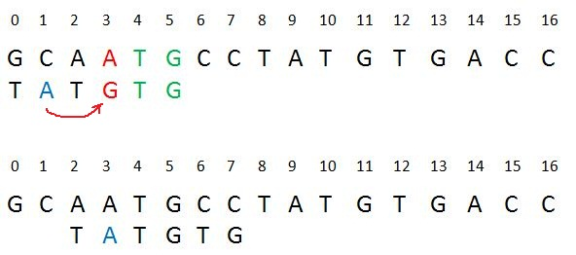
Bad Character Heuristic
Case 1 – Mismatch become match
We will lookup the position of the last occurrence of the mismatched character in the pattern, and if the mismatched character exists in the pattern, then we’ll shift the pattern such that it becomes aligned to the mismatched character in the text T.

Slide 5
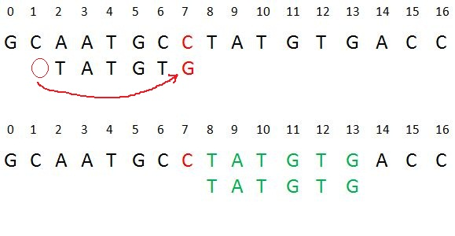
Bad Character Heuristic
Case 2 – Pattern move past the mismatch character
We’ll lookup the position of last occurrence of mismatching character in pattern and if character does not exist we will shift pattern past the mismatching character.

Slide 6
Boyer Moore Time and Space Complexity
Time Complexity : O(n x m)
Auxiliary Space: O(1)
Worst Case : The Bad Character Heuristic may take O(m*n) time in worst case. The worst case occurs when all characters of the text and pattern are same.
For example, txt[] = “AAAAAAAAAAAAAAAAAA” and pat[] = “AAAAA”.
Best Case : The Bad Character Heuristic may take O(n/m) in the best case. The best case occurs when all the characters of the text and pattern are different.

Slide 7
Boyer Moore Bad Match Table
In order to apply bad character heuristic, In Boyer Moore algorithm, we create a Bad Match Table first on the given pattern.
No. of entries in Bad Match Table : Total unique characters in the given pattern + 1
Entries for a character in Bad Match Table : length – index – 1
where, length is length of the pattern, index is index position
of a character in the pattern.
0 1 2 3 4
Example : Pat = “A B A B C”
Bad Match Table :
A | B | C | *
2 | 1 | 4 | 4

Slide 8
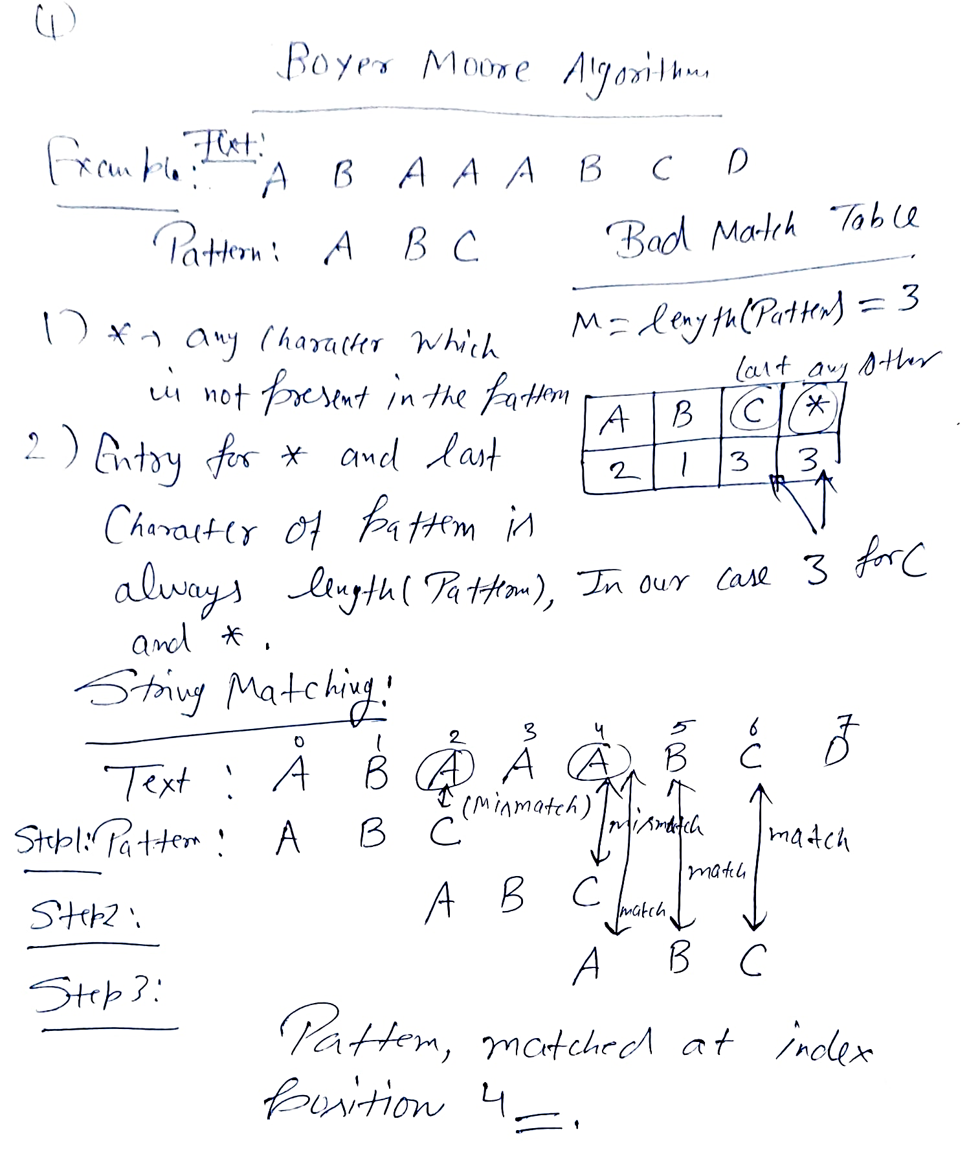
Boyer Moore Example

Slide 9
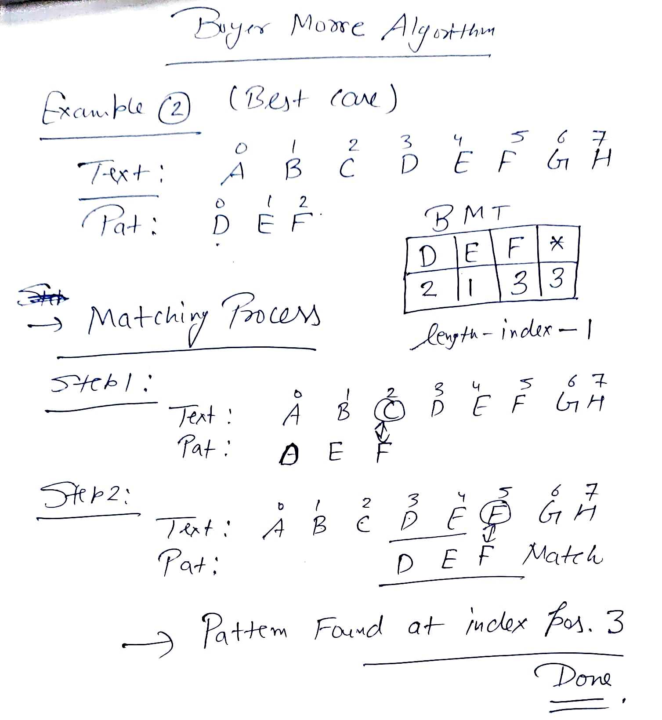
Boyer Moore Example

